Slide 1
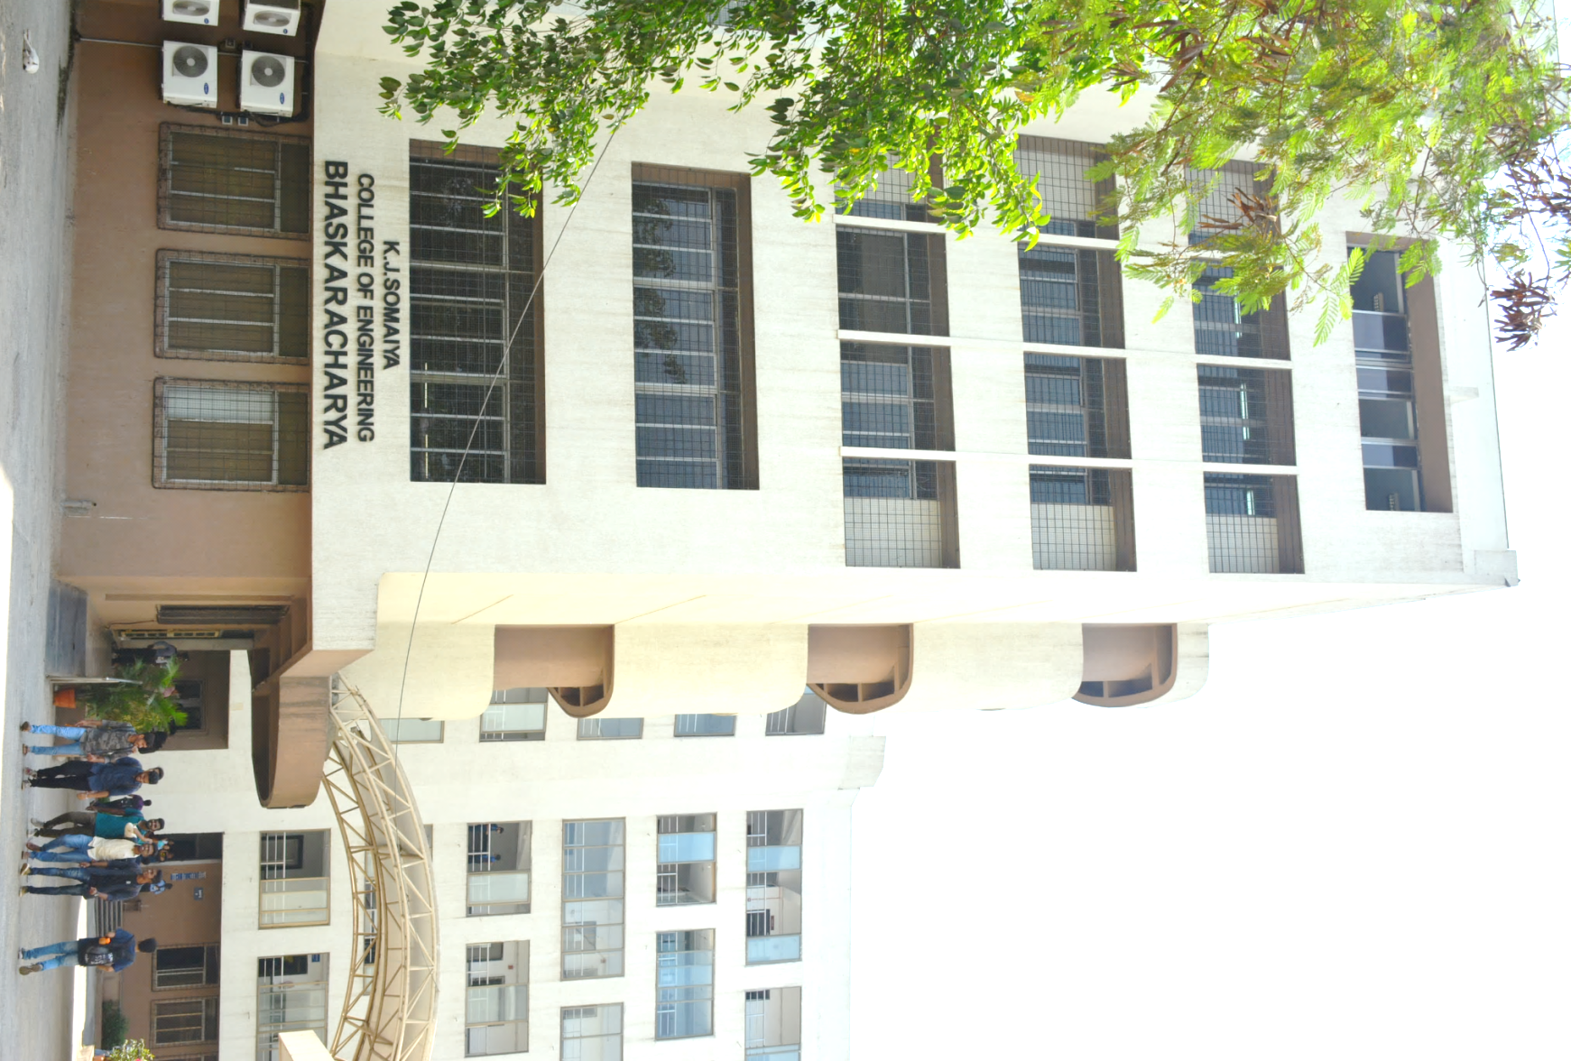
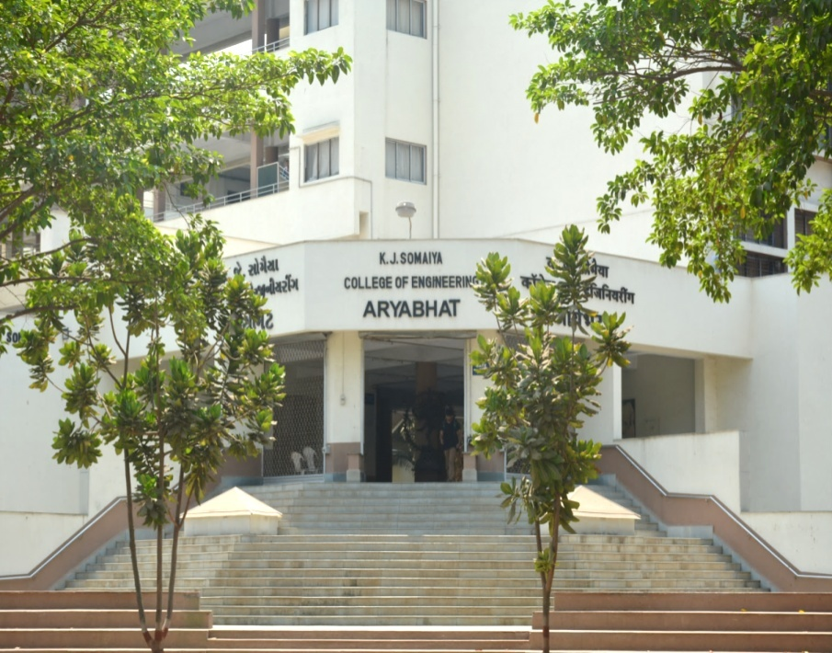
K J Somaiya College of Engineering, Mumbai-77
(Constituent college of Somaiya Vidyavihar University)
Department of Electronics and Telecommunication Engineering

Slide 2
IOT & ML BASED SMART VEHICLE
GROUP NO 27
JAY JAIN(1813022)
ASHISH KHARE(1813023)
MANIK PAHALWAN(1813032)
DARSHAN SHAH(1813049)
Under The Guidance Of – Dr. Sandeep Sainkar

Slide 3
WHY DRIVERLESS CARS !
Prevention of Car Crash
Drop In Harmful Emission thus environment friendly
Reduction of Travelling Time
Improve Traffic Efficiency
Improve Fuel Economy
Eliminate Stop and Go Traffic Waves
Proving Easy service for people incapable to Drive

Slide 4
BACKGROUND
At the 1939 World's Fair, General Motors created the first self-driving car model. It was an electric vehicle guided by radio-controlled electromagnetic fields and operated from magnetized metal spikes embedded in the roadway. This model turned into a reality in 1958.
In 1960, Ohio State University's Communication and Control Systems Laboratory launched a project to develop driverless cars which were activated by electronic devices embedded in the roadway
Many major automotive manufacturers, including General Motors, Ford, Mercedes Benz, Volkswagen, Audi, Nissan, Toyota, BMW, and Volvo, are in the process of testing driverless car systems. BMW has been testing driverless systems since around 2005,while in 2010, Audi sent a driverless Audi TTS to the top of Pike’s Peak at close to race speeds.

Slide 5
AIM OF THE PROJECT
Create prototype of self driving car
Understand and demonstrate basic principles of self driving car
Briefly demonstrate the working of self driving car
Stop sign detection and avoidance based on Neural network.
Demonstrate the extent of Machine Automation we can achieve without any human input

Slide 6
Technical Aspect
Hardware
4 Channel RC Car
Raspberry PI
Arduino Uno
L298 H Bridge
External Props
Tech Stack
-C++/Python
-OpenCV
- Wiring Pi /Chrono /raspicam/Numpy / Sklearn /matplotlib
- Embedded C

Slide 7
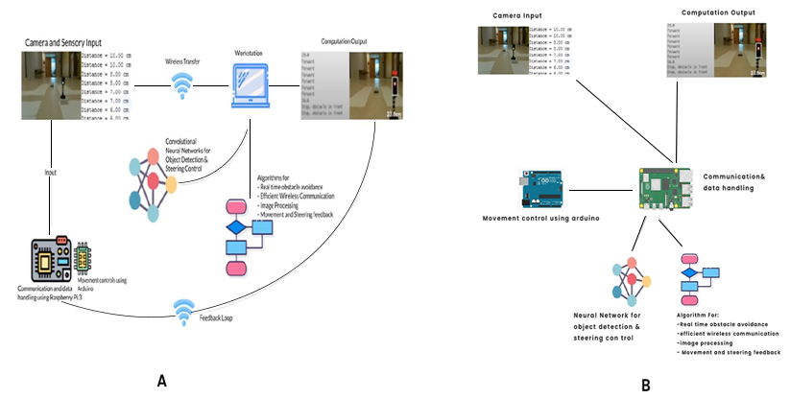
PLAN A vs. PLAN B

Slide 8
PLAN A vs PLAN B WWWWW
PLAN A | PLAN B
A separate workstation is required for the purpose of computation. | Raspberry Pi is the workstation.
Convergence time is high. | Convergence time is low.
Connections are complex. | Connections are quite handy.
Workstation always needs to be near the car for the communication to be possible. Hence, PC need to be physically carried while car is in motion. | Since, workstation is in the car itself no need to physically carry anything.

Slide 9
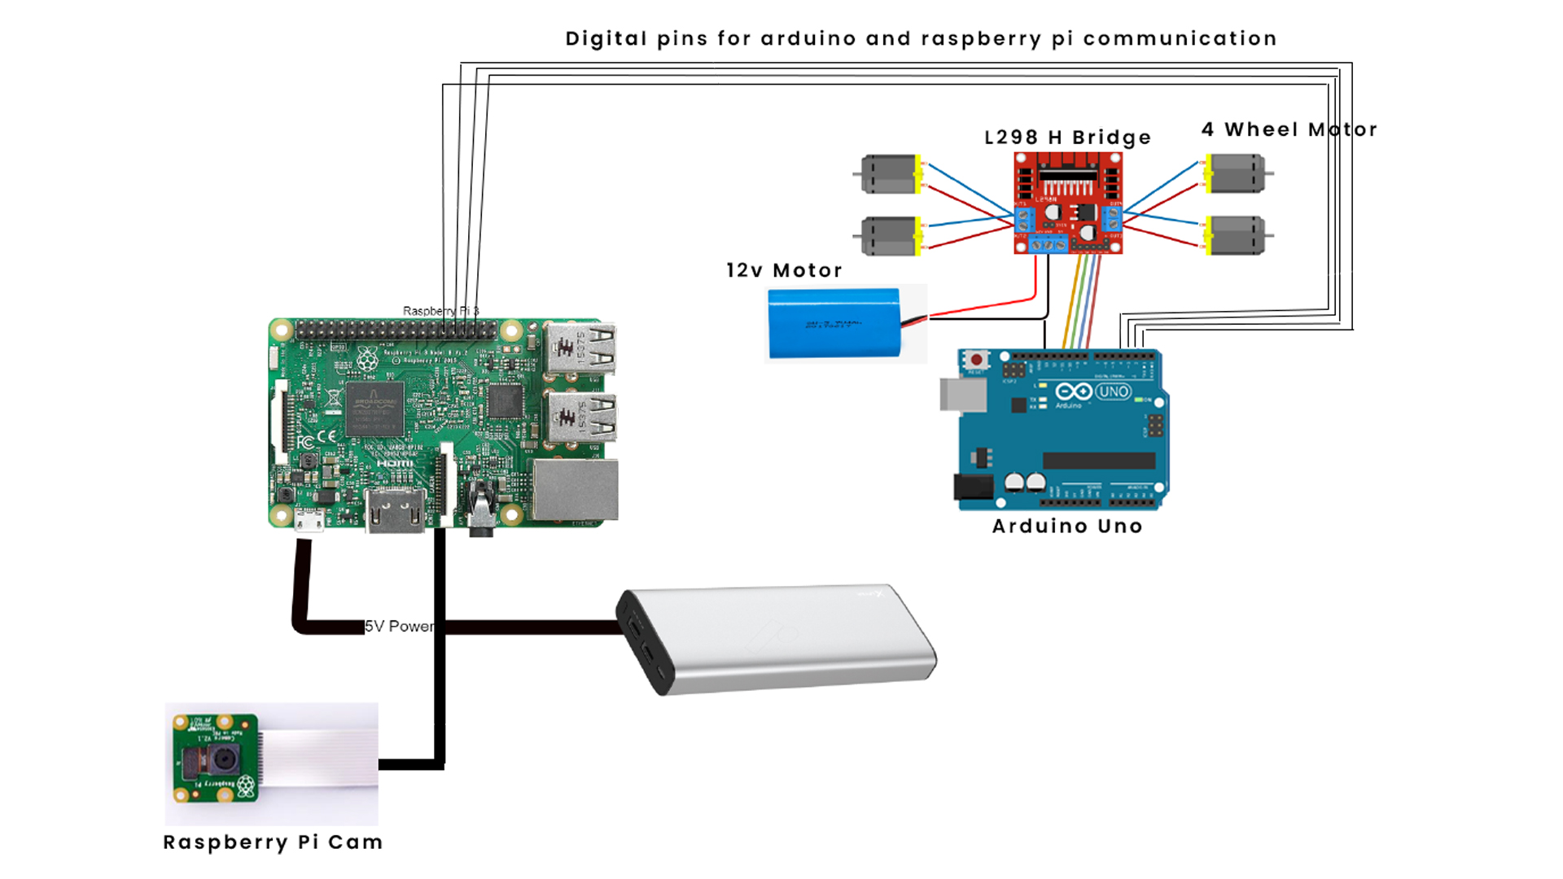
Connection Overview

Slide 10
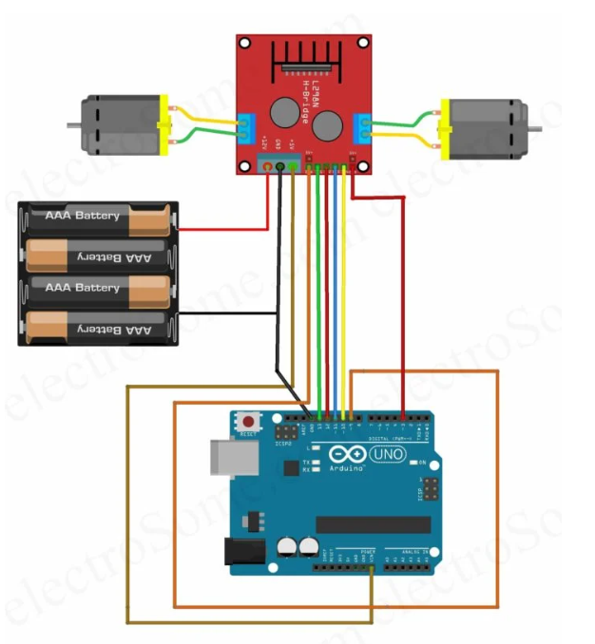
Connections Arduino Uno -L298 H Bridge

Slide 11
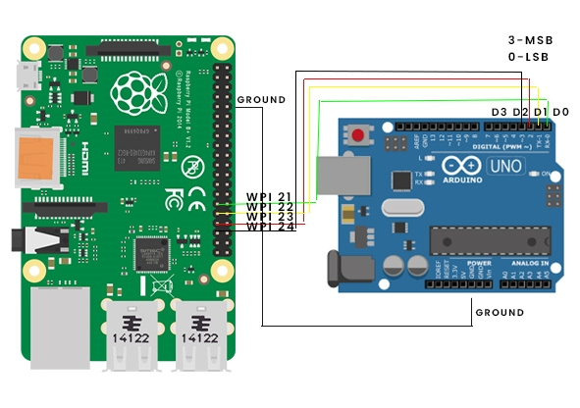
Connections Raspberry Pi – Arduino Uno

Slide 12
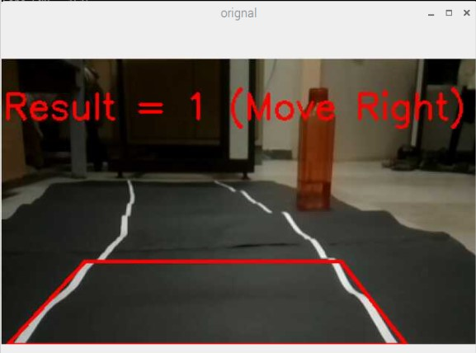
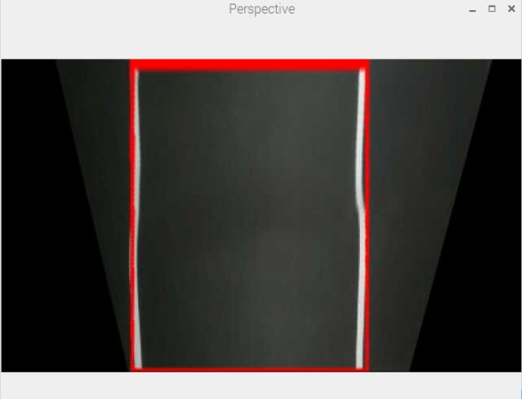
IMAGE PROCESSING
REGION OF INTEREST
PERSPECTIVE WARP

Slide 13
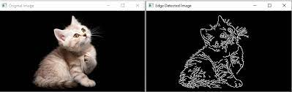
CANNY EDGE DETECTION
Image source - Google
Smoothening with gaussian filter
Compute derivative of filtered image
Find magnitude and orientation of gradient
Apply “Non Maximum Supression”
Apply Hysteresis Threshold

Slide 14
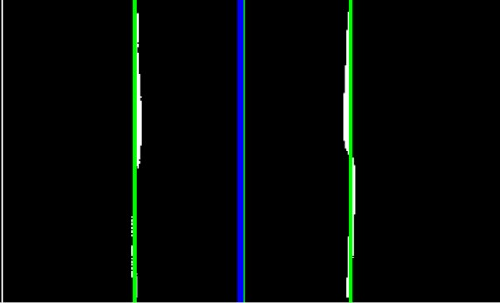
Calibration of Lane Center & Frame Center

Slide 15
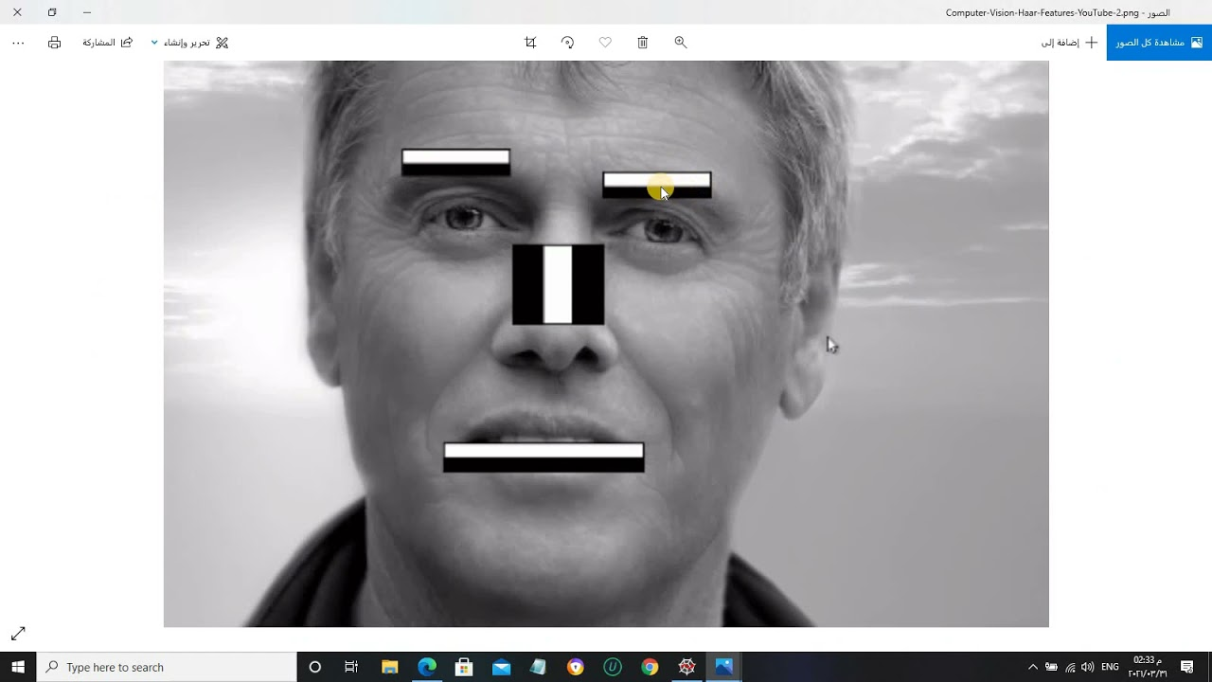
HAAR CASCADE CLASSIFIER
Image source - Google

Slide 16
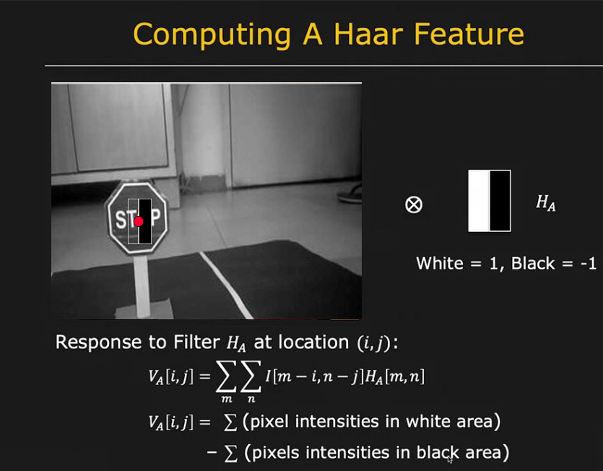
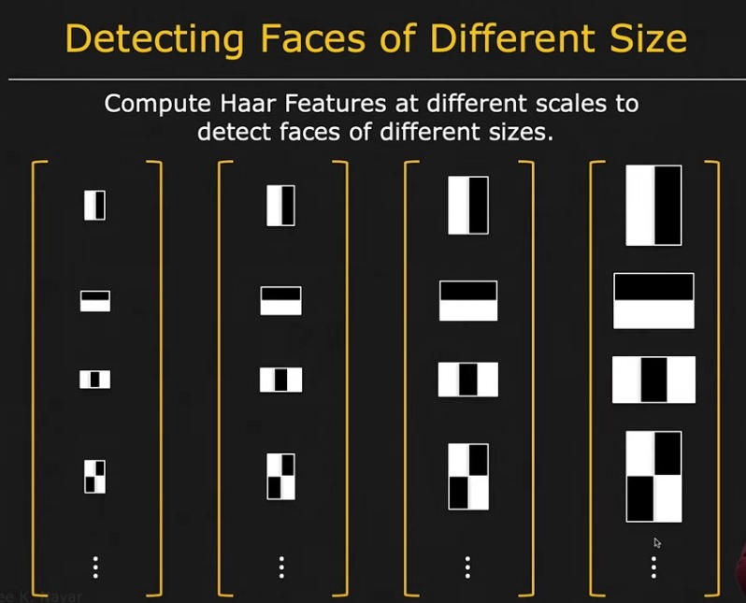
HOW FEATURES WILL BE DETECTED?
Image source - Google

Slide 17
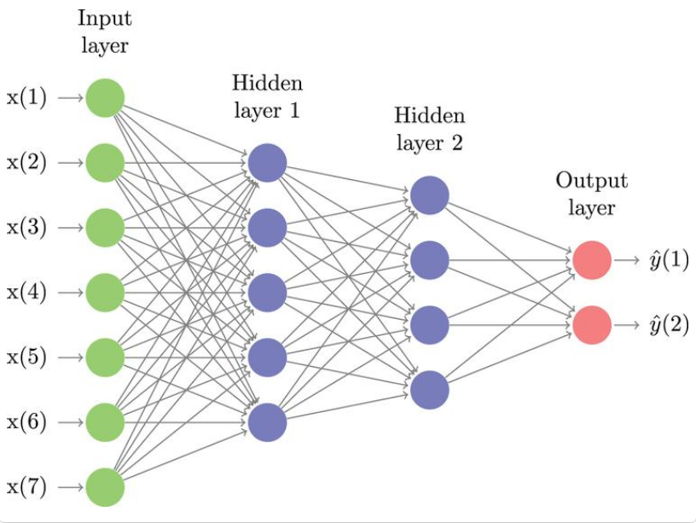
NEURAL NETWORKS
Image source - Google

Slide 18
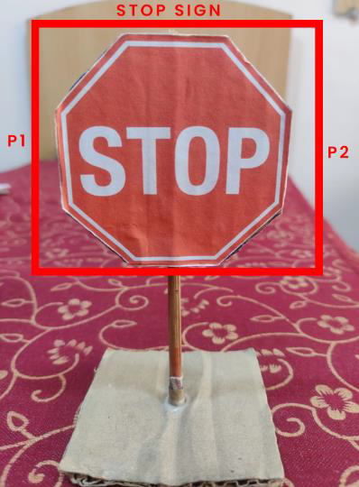
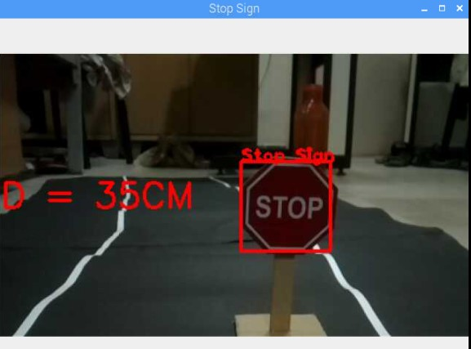
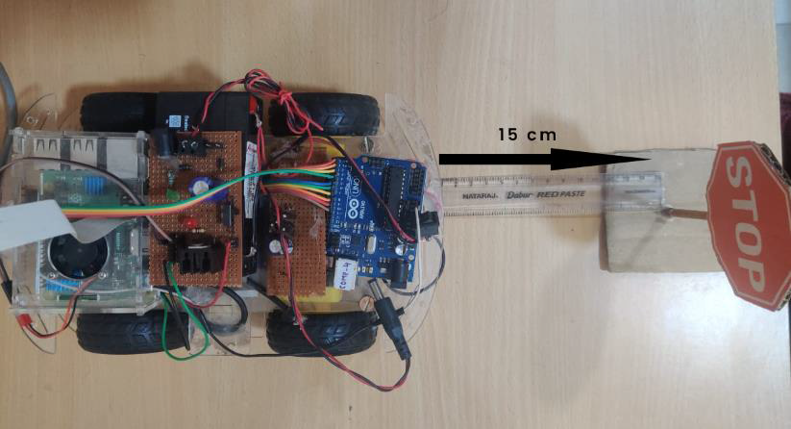
Distance Calculation For Stop Sign
Step 1 : Distance of end points is calculated from frame image by raspberry pi also it has linear relationship with actual distance.
Step 2 : An equation is calculated
Step 3 : equation is used to calculate actual distance

Slide 19
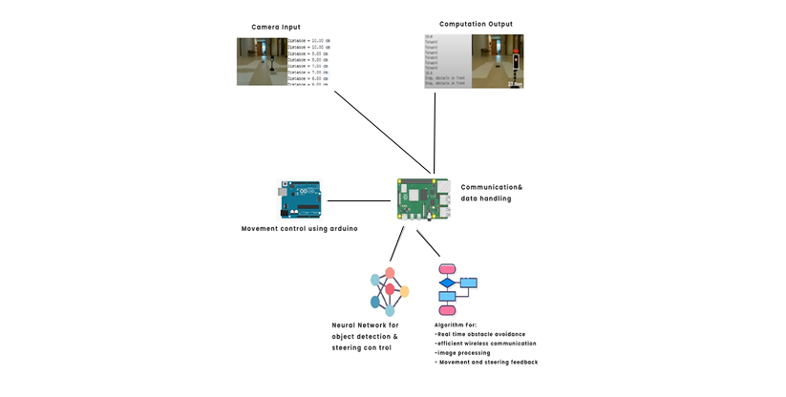
WORKING

Slide 20
Working
Raspberry PI microcontroller grabs input from the camera, for computation .
It processes input images (data) to detect distance between sign and its detection (stop sign) and collision avoidance.
An Open CV computation on the Raspberry sends the predictions for steering based on the input image from the camera.
All the computed data is used by PI to control Arduino Uno which decides the next steps for the movement of the car.

Slide 21
Future Scope
Indian Law
There is currently no special regulation in India to control self-driving automobiles
But one of the most pressing questions is whether India should adopt the British model, in which the owner is accountable even if the AI makes a mistake, or the German model, in which the maker of the automobile is liable when the AI makes a mistake.
If reference is drawn from the Consumer Protection Act, 2019, which states that manufacturer is responsible to compensate for any harm caused to consumer by any defective product manufactured or sold.
So if we consider AI as a product then the manufacturer is totally liable for the damage caused by this.
Image source google

Slide 22
Challenges that AV face in India
The Indian government is concerned about the loss of jobs as a result of automation.
The government's stance on this problem may be one of the main reasons why global automakers do not consider India as a promising market.
Another major hurdle for AVs in India is inadequate road and transportation infrastructure, which is responsible for the majority of traffic accidents and deaths in the country.

Slide 23
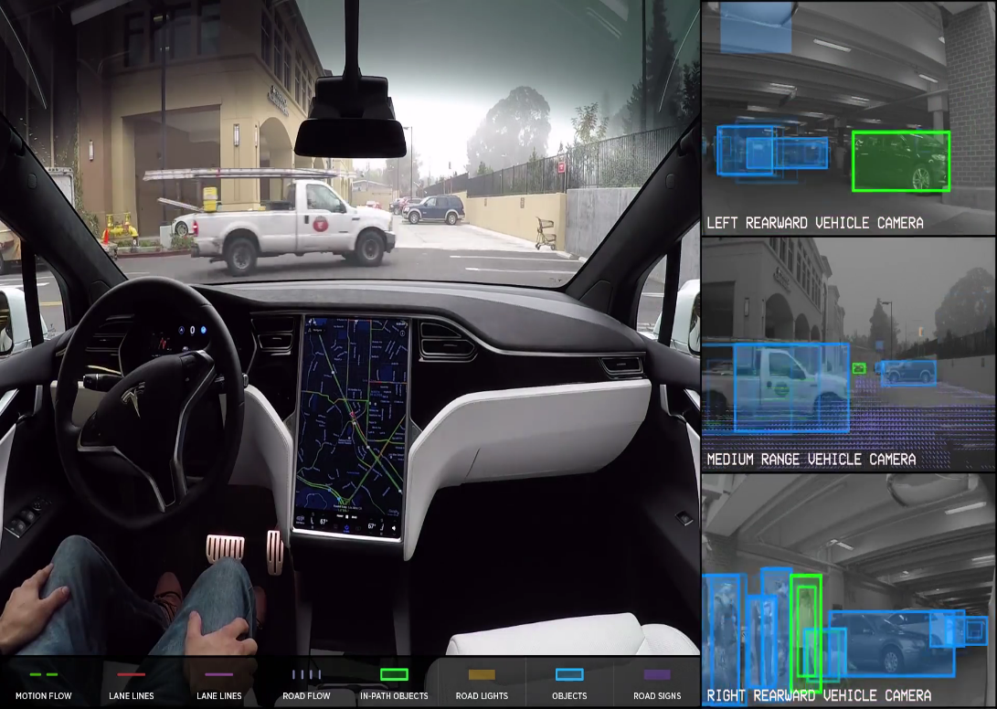
What is Tesla Doing?
Every single company working on self drive car uses LIDAR
But Tesla uses Computer Vision as the company is highly focused on cost and making affordable cars
Image source - Google

Slide 24
Indian Startups in prototype phase
Minus Zero
Creates self-driving automobiles for Indian highways.
They have created an artificial intelligence that can accurately extract 3D information from a 2D camera picture.
Flux Auto
A Bangalore-based firm is developing self-driving trucks.
It effectively facilitates functions such as lane keeping, cruise control, and collision avoidance.
Instead of Lidar, the firm is employing vision algorithms with inexpensive cameras with fast reaction rates to make the vehicle as cheap as possible.

Slide 25
What Can we Do?
Detect other signs like slow sign, traffic signals asnd car can act accordingly.
Detect any object using Ultrasonic sensor.
Avoid syncing between Raspberry Pi and Arduino Uno by making a capacitor based PCB.
Balance the weight of the car and improve height width ratio.

Slide 26
REFERENCES
[1]https://zhengludwig.wordpress.com/projects/self-driving-rccar/
[2]http://www-di.inf.puc-rio.br/~endler/students/ProjetosFinai
s/MarcPaulon-Proposta.pdf
[3]https://assets.publishing.service.gov.uk/government/uploads
/system/uploads/attachment_data/file/401562/pathway-driverless
-cars-summary.pdf
[4]https://www.youtube.com/watch?&v=BBwEF6WBUQs

